Slide 1


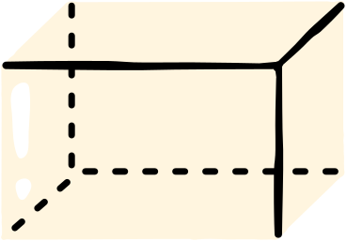
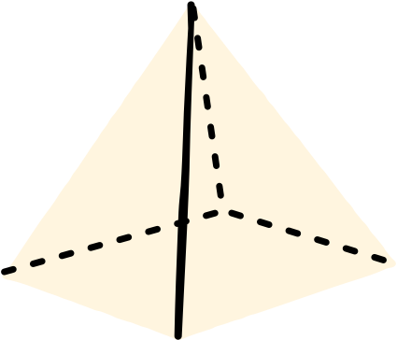

COMBINING
LIKE
TERMS
Understand how to simplify
Algebraic expressions

Slide 2


IN TODAY'S LESSON, YOU WILL BE ABLE TO...
Identify like terms in
algebraic expressions
Simplify expressions by combining like terms using addition and subtraction

Slide 3

LIKE AND UNLIKE TERMS
LIKE TERMS
UNLIKE TERMS
Terms that have the same variable
raised to the same power.
Terms that have different variables
and/or different powers.
3x + 5x
3x + 5y
7t + 6t
7t + 6v
2xy + 6xy
2xy + 6x
5y + 3y
5y + 3y
2
2
2

Slide 4
TICK THE EXPRESSIONS WITH LIKE TERMS
4x + 5x
4xy + 5xy
2
4x + 5y
4x + 5x
4xy + 5y
4y + 5y

Slide 5

TICK THE EXPRESSIONS WITH LIKE TERMS
4x + 5x
4xy + 5xy
2
4x + 5y
4x + 5x
4xy + 5y
4y + 5y

Slide 6

EXAMPLE
1
Identify like terms
7x + 4y - 3x + 2y
2
Group like terms
7x + 4y - 3x + 2y
7x - 3x + 4y + 2y
3
Combine like terms
4x + 6y

Slide 7

CHECKPOINT
Match up the expressions with their simplified answer
9y - 7x + 3y + 4x
x + 2y
4x + 3y + 5x - 5y
12y - 3x
5y - 7x - 3y + 8x
9x - 2y

Slide 8


ANSWER KEY
How many did you get correct?
9y - 7x + 3y + 4x
12y - 3x
4x + 3y + 5x - 5y
9x - 2y
5y - 7x - 3y + 8x
x + 2y

Slide 9

CHALLENGE
Can you simplify the following expression?
2
2
6x - 3x + 4xy + 7x - 5xy - 4x

Slide 10
SOLUTION
2
2
6x - 3x + 4xy + 7x - 5xy - 4x
1
6x - 3x + 4xy + 7x - 5xy - 4x
Identify like terms
2
2
2
2
2
Group like terms
6x - 4x + 4xy - 5xy + 7x - 3x
3
2
Combine like terms
2x - xy + 4x

Slide 11


REMEMBER THESE STEPS:
Can you simplify the following expression?
1
2
3
Identify like terms
Group like terms
Combine like terms

Slide 12


Do you have any questions?
Feel free to ask.

Slide 13



THANK YOU!

Slide 14
RESOURCE PAGE
Use these design resources in your Canva Presentation.
Fonts
Design Elements
This presentation template
uses the following free fonts:
TITLES:
ANTON
BODY COPY:
POPPINS
You can find these fonts online too.
Colors
#F55D98
#4BA34C
#FFDE59
DON'T FORGET TO DELETE THIS PAGE BEFORE PRESENTING.

Slide 15

CREDITS
This presentation template is free for everyone to use thanks to the following:
for the presentation template
Pexels, Pixabay
for the photos
Happy designing!

